Slide 1


Slide 2

Today
Group Project Review
Color
Color Theories
Creating Color Schemes
Branding

Slide 3
Group Project
Mission: Redesign Reddit!
Will create a UI-mockup of your redesign of Craigslist
Only use HTML5/CSS
Create 4 “Views”
Main Page
Search Result
Item Page
1 Extra View of your choice
Will work with a group of 3 ~ 5 people

Slide 4
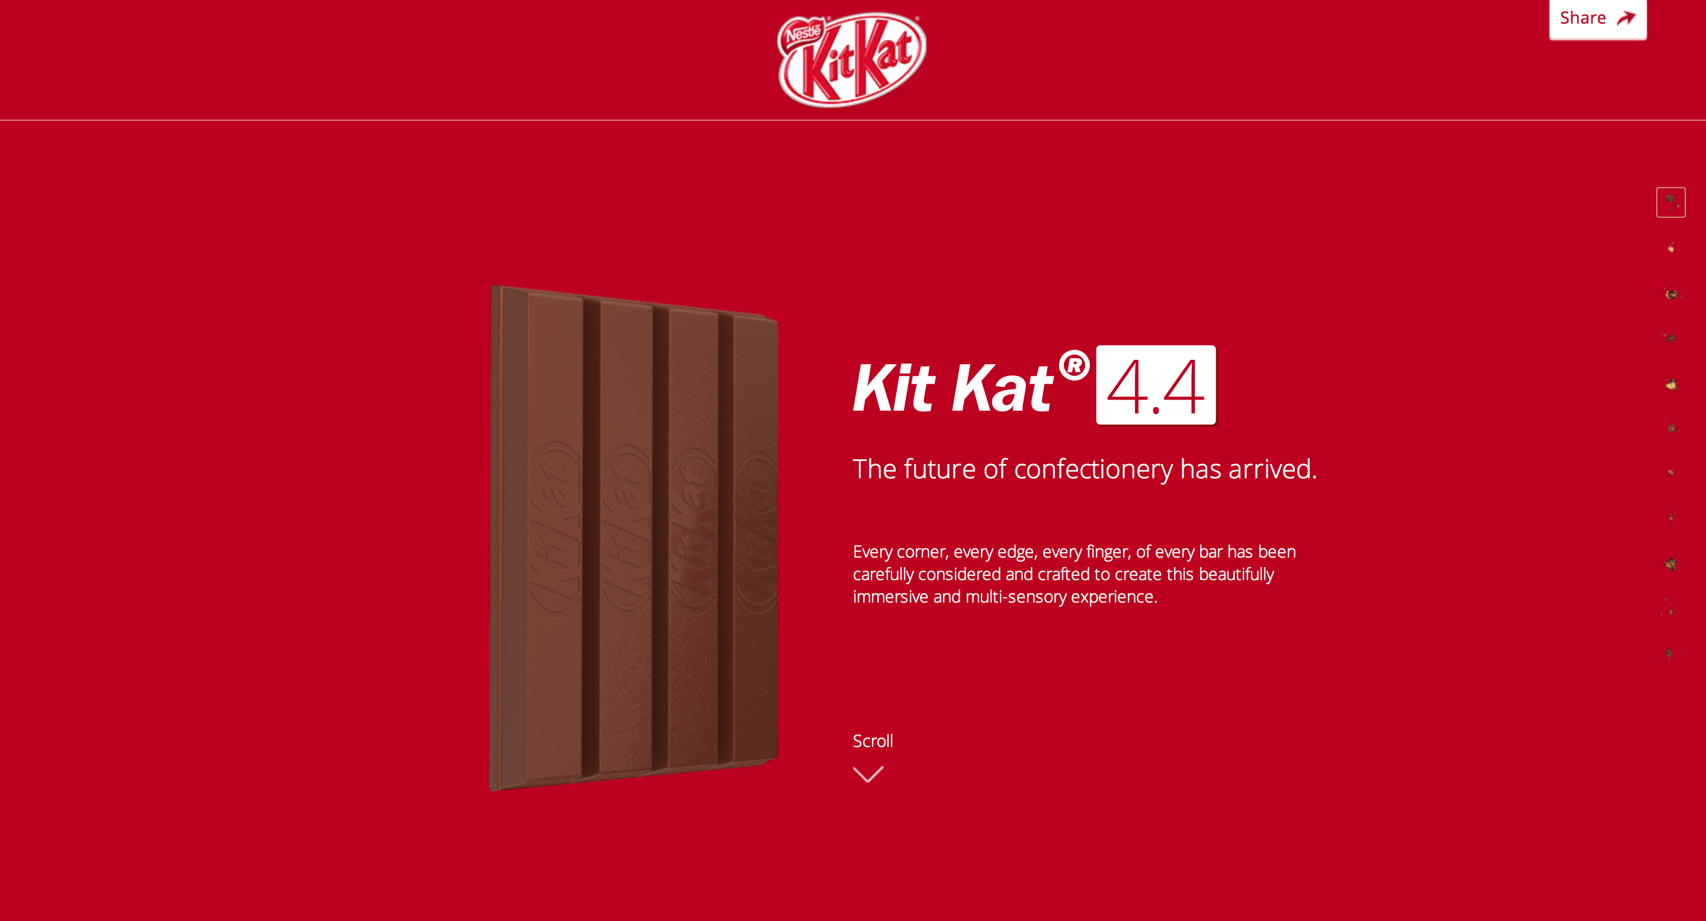
Landing Page: Kit Kat

Slide 5

Landing Page: Coffely

Slide 6
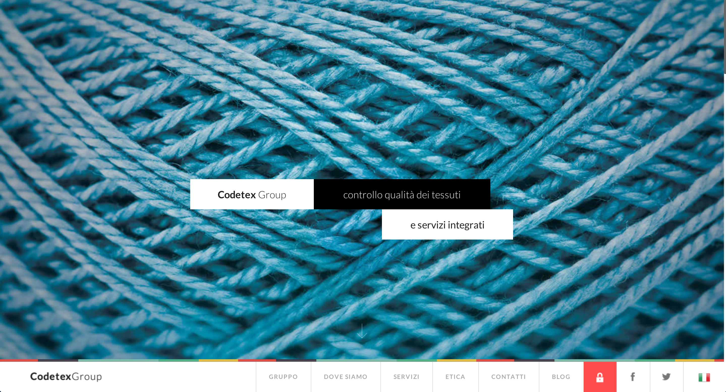
Landing Page: Codetex

Slide 7
Color Theory
Color determines a large portion of the visitors’ emotion when they visit the website
Important to know:
What to use – red, blue, or green …
Where to use – to separate a box from container, button …
How to use – spam red, blue, and green all over vs. just red

Slide 8
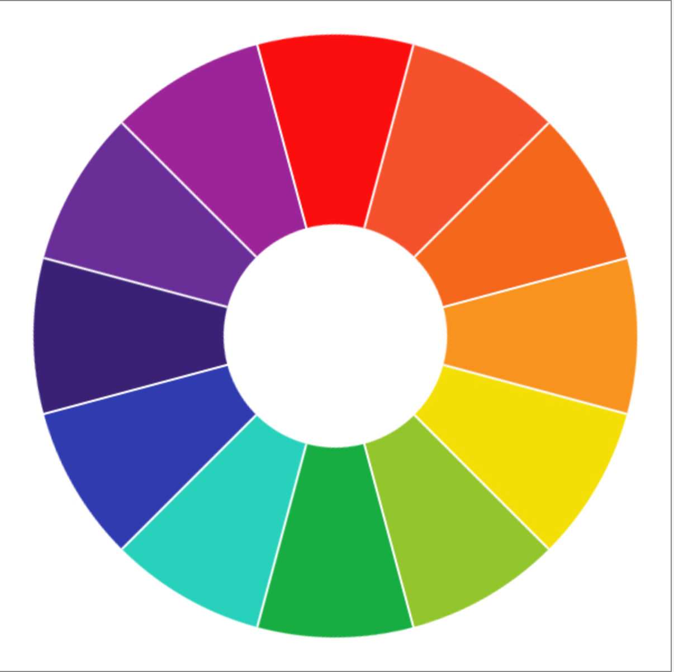
Color Wheel
Shows main color hues and how they relate with each other

Slide 9
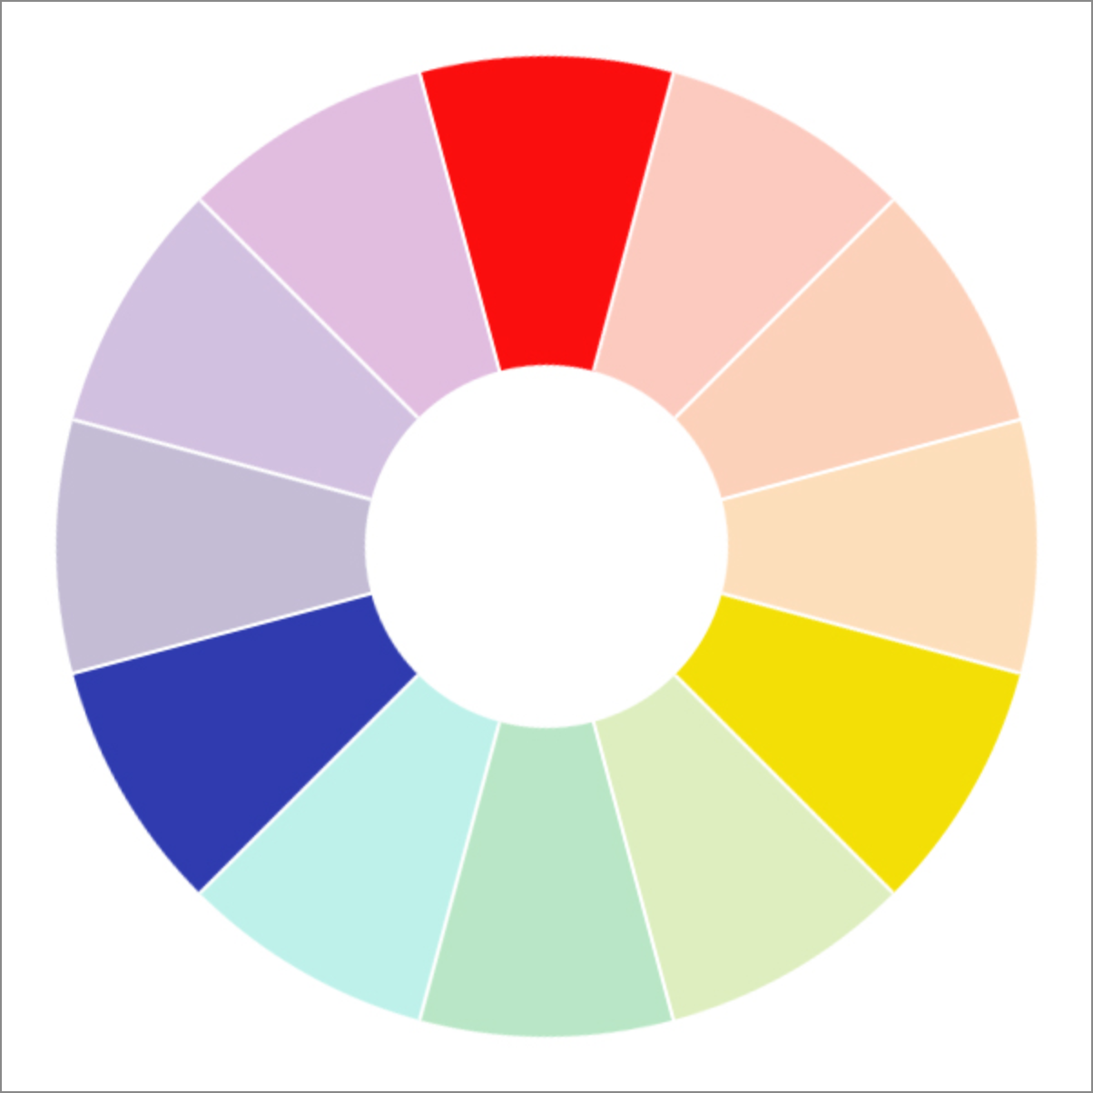
Color Wheel - Primary

Slide 10
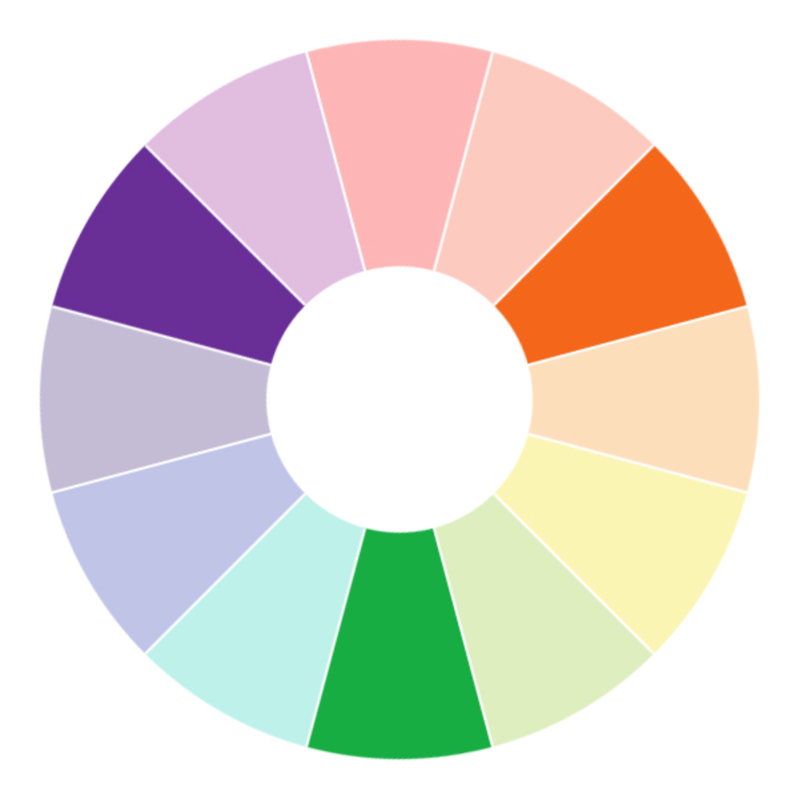
Color Wheel - Secondary

Slide 11
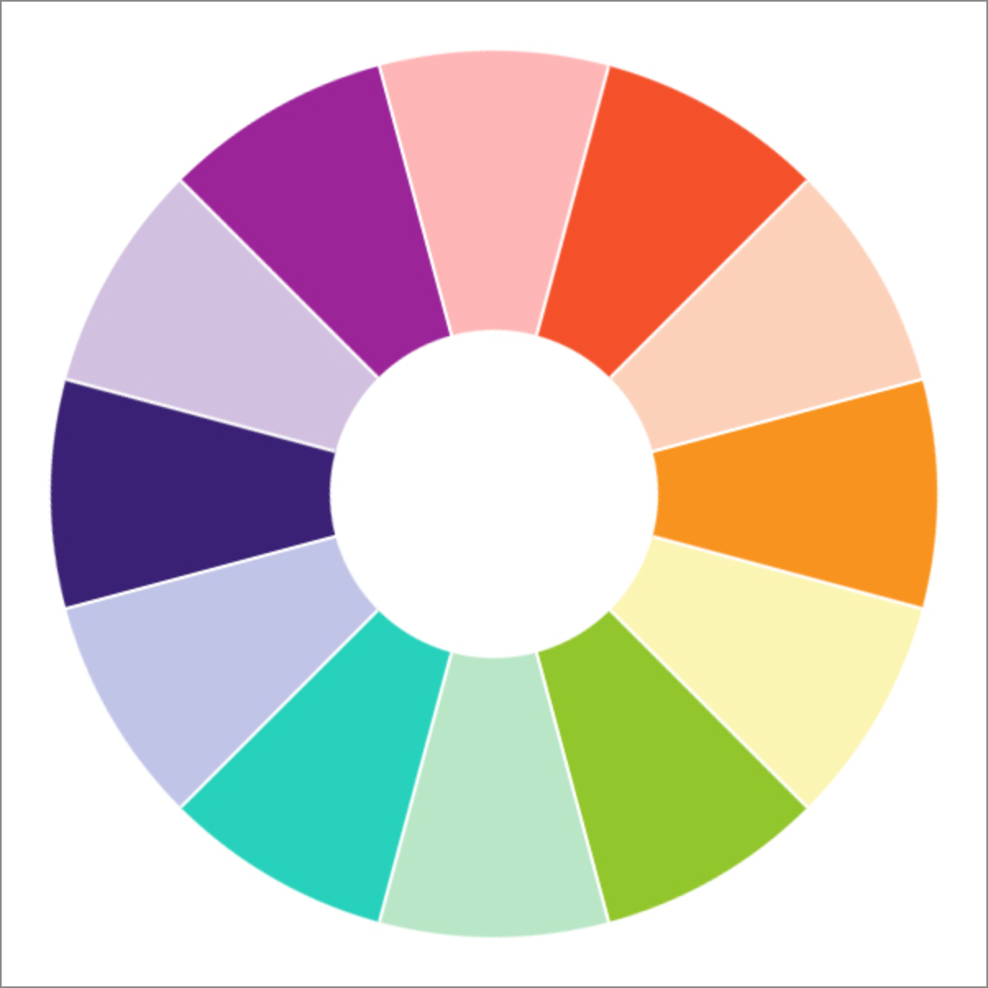
Color Wheel - Tertiary

Slide 12
Red
Strong & Emotionally-intense color
Used widely in: Relationship websites & Food websites
Use it as an “accent” color, rather than as a main focal color
Too bright & strong – can get nauseating and irritating
Very widely used as a cancel button

Slide 13
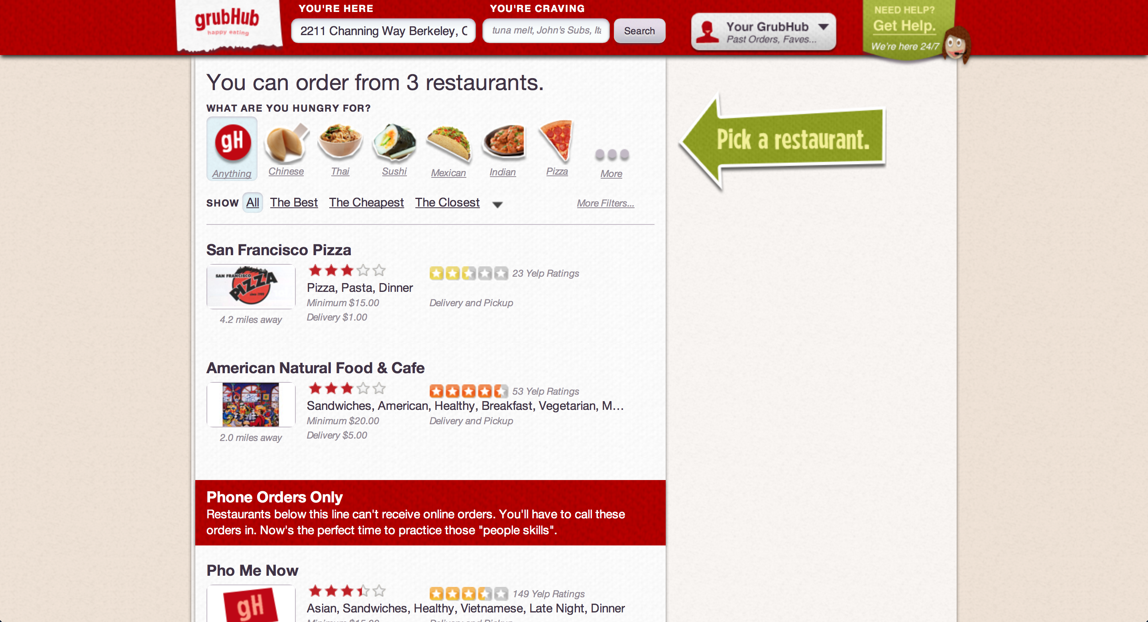
Grubhub: Red as accent color

Slide 14

Mixd: Red as focal color

Slide 15
Yellow
Bright & Creative color
Used widely in: Shopping websites
Why? Induces quick-decision making!
Prone to making text hard to read due to lack of contrast
Very widely used as a warning sign

Slide 16
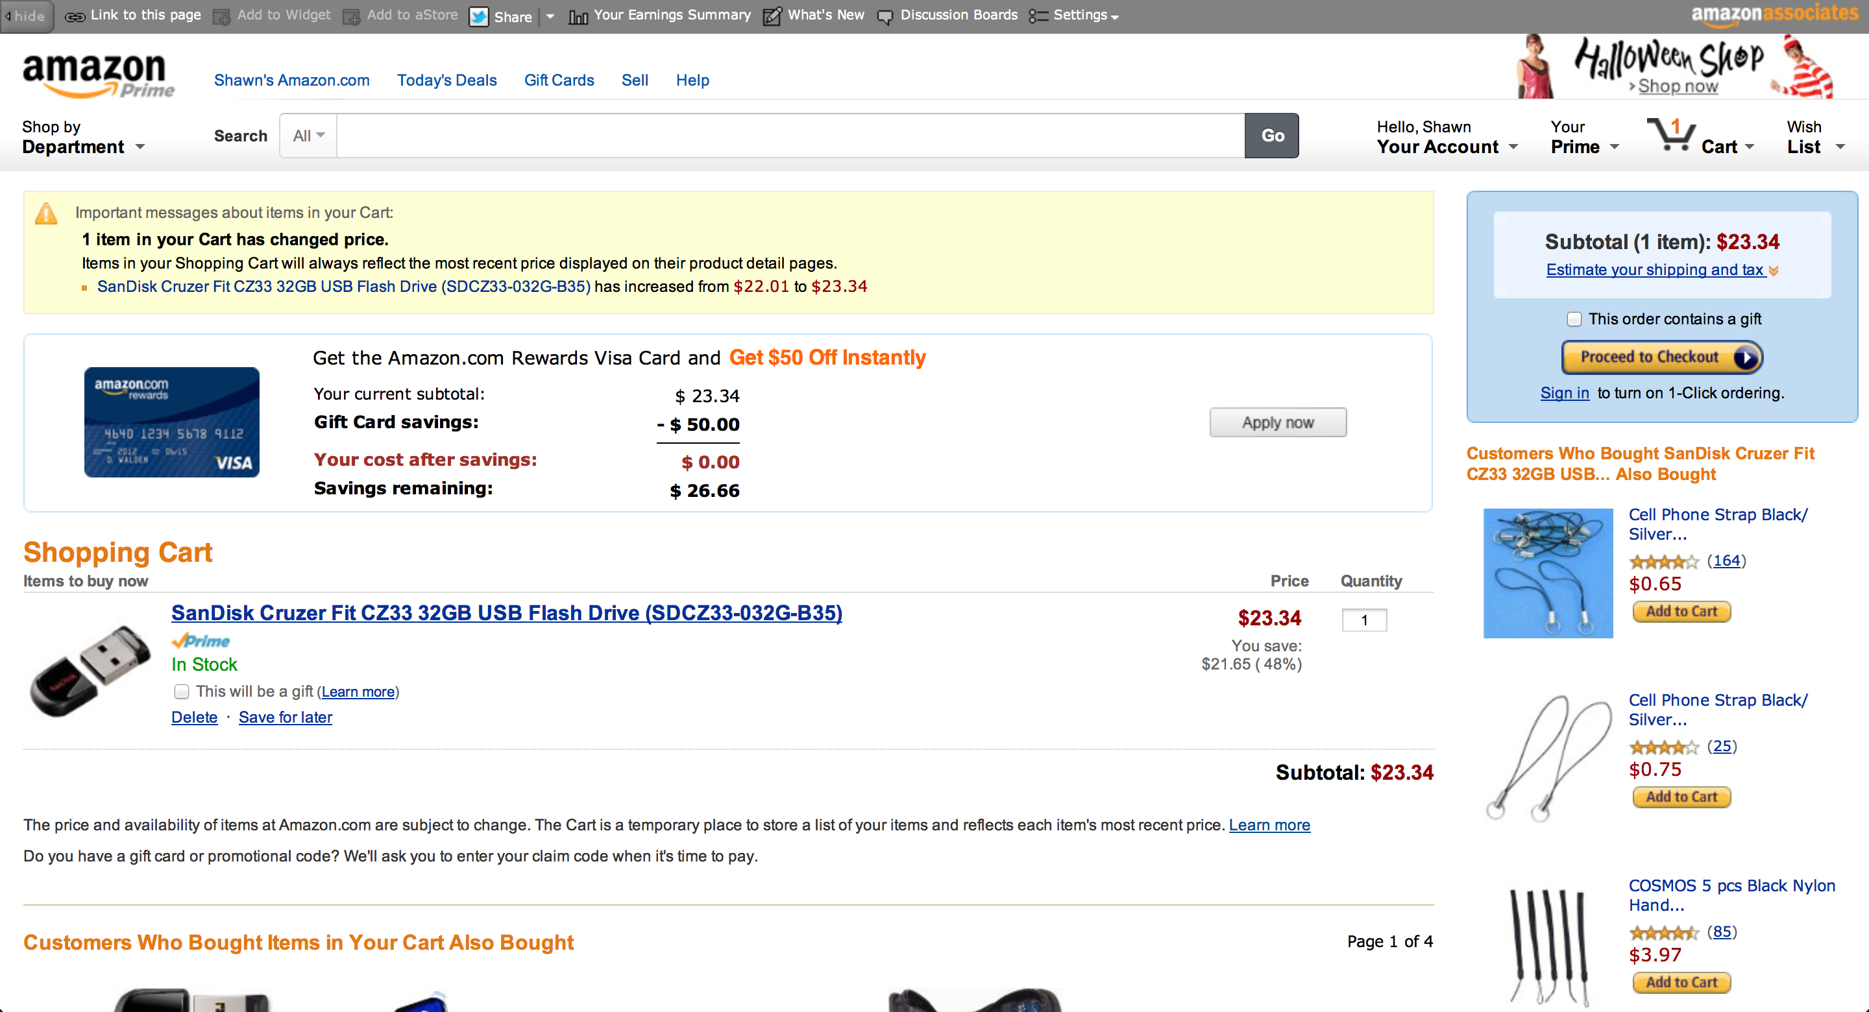
Amazon: Yellow as a decision-inducer & warning sign

Slide 17
Blue
Reliable & Calm color
Used widely for masculine and corporate audiences
Fun Fact: Appetite “suppressor”
Suitable for many “general-purpose” websites
Ex. Facebook, Tumblr, Twitter, Walmart, Microsoft, …

Slide 18
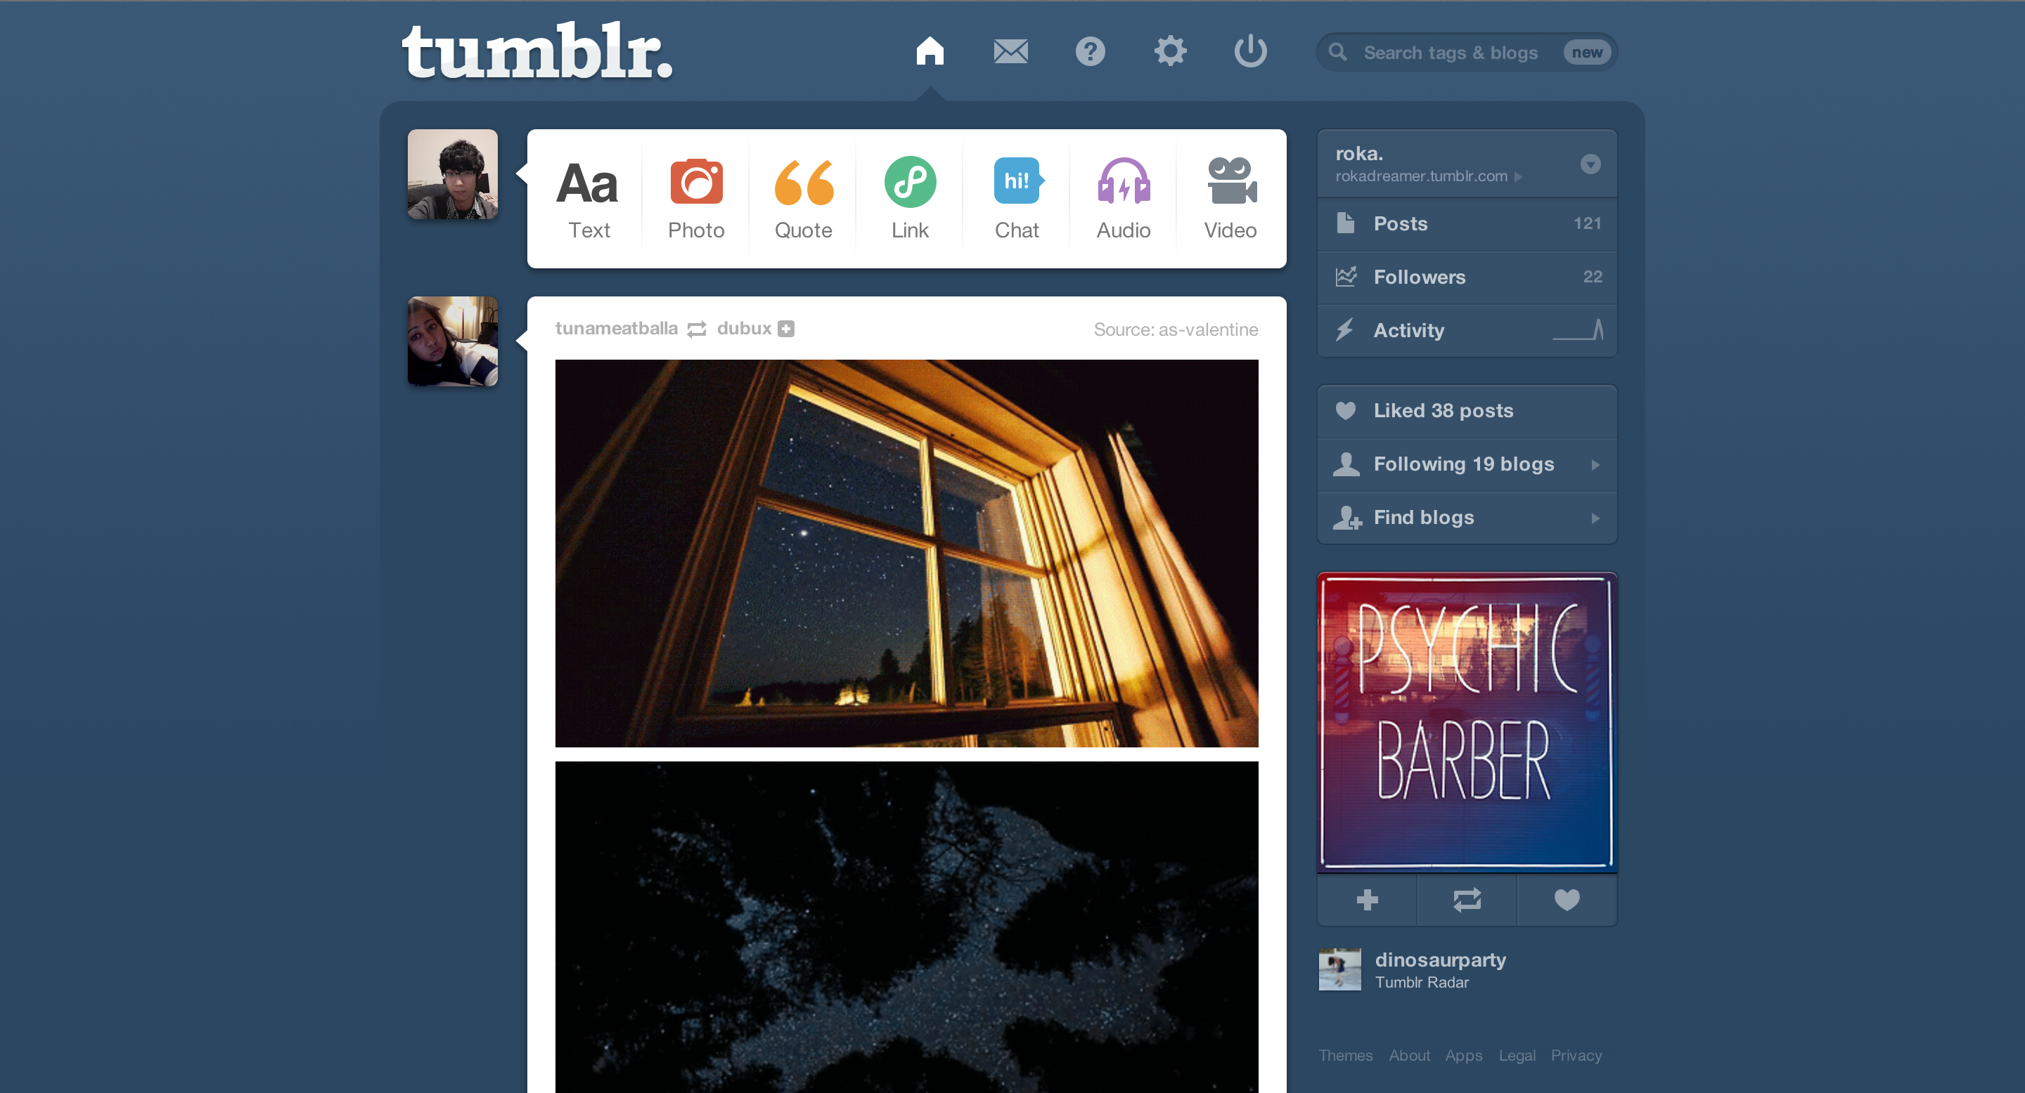
Blue: Tumblr

Slide 19
Variation of Color
Hue: Color itself
Tint: Color itself + White
Shade: Color itself + Black
Tone: Color itself + Grey

Slide 20
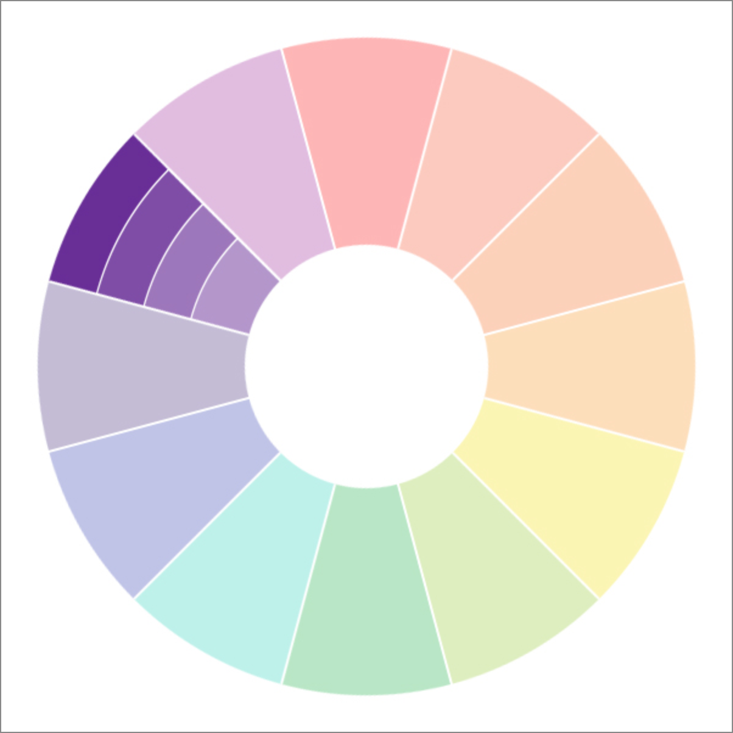
Variation of Color

Slide 21
Color Scheme
A set of color that you use in a website
Creates a theme & direction for your website
Responsible for emotional appeal
Usually only 2-3 Main “Theme” Color in your website

Slide 22
Color Scheme: Themes
Primary Color: Theme for your website
Use for Navigation bar, logo icon, etc.
Secondary Color: Use for alternative accents like submit buttons
Cancel Color: Use for warning or cancel buttons

Slide 23
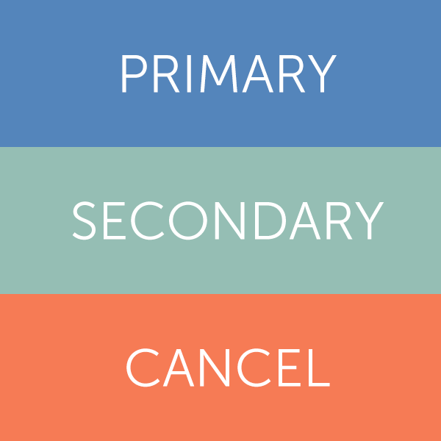
Color Scheme: Themes

Slide 24
Color Scheme
Neutral Light Color: Use for background
White is a universal neutral light color
Alternatives include beige
Neutral Dark Color: Use for special modules like Popovers and Navigations
Black is a universal neutral dark color
Alternatives include dark navy

Slide 25


Color Scheme: Neutrals

Slide 26
Color Scheme: Overview
5 Main components:
Primary Color
Secondary Color
Anti Color
Neutral Light Color
Neutral Dark Color
From this color scheme, adjust the tone of the color (add some dose of white & black to adjust brightness) to create a full color pallette

Slide 27

Color Scheme: Pallette

Slide 28
Contrast
Most of emphasis is established by providing strong contrast
White ⬄ Dark
Black ⬄ Light
Try not to place white on light background, or black on dark background
Black on color usually does not go well => Use white on color
Color on Black is usually quite effective
Notes:
DEMO

Slide 29
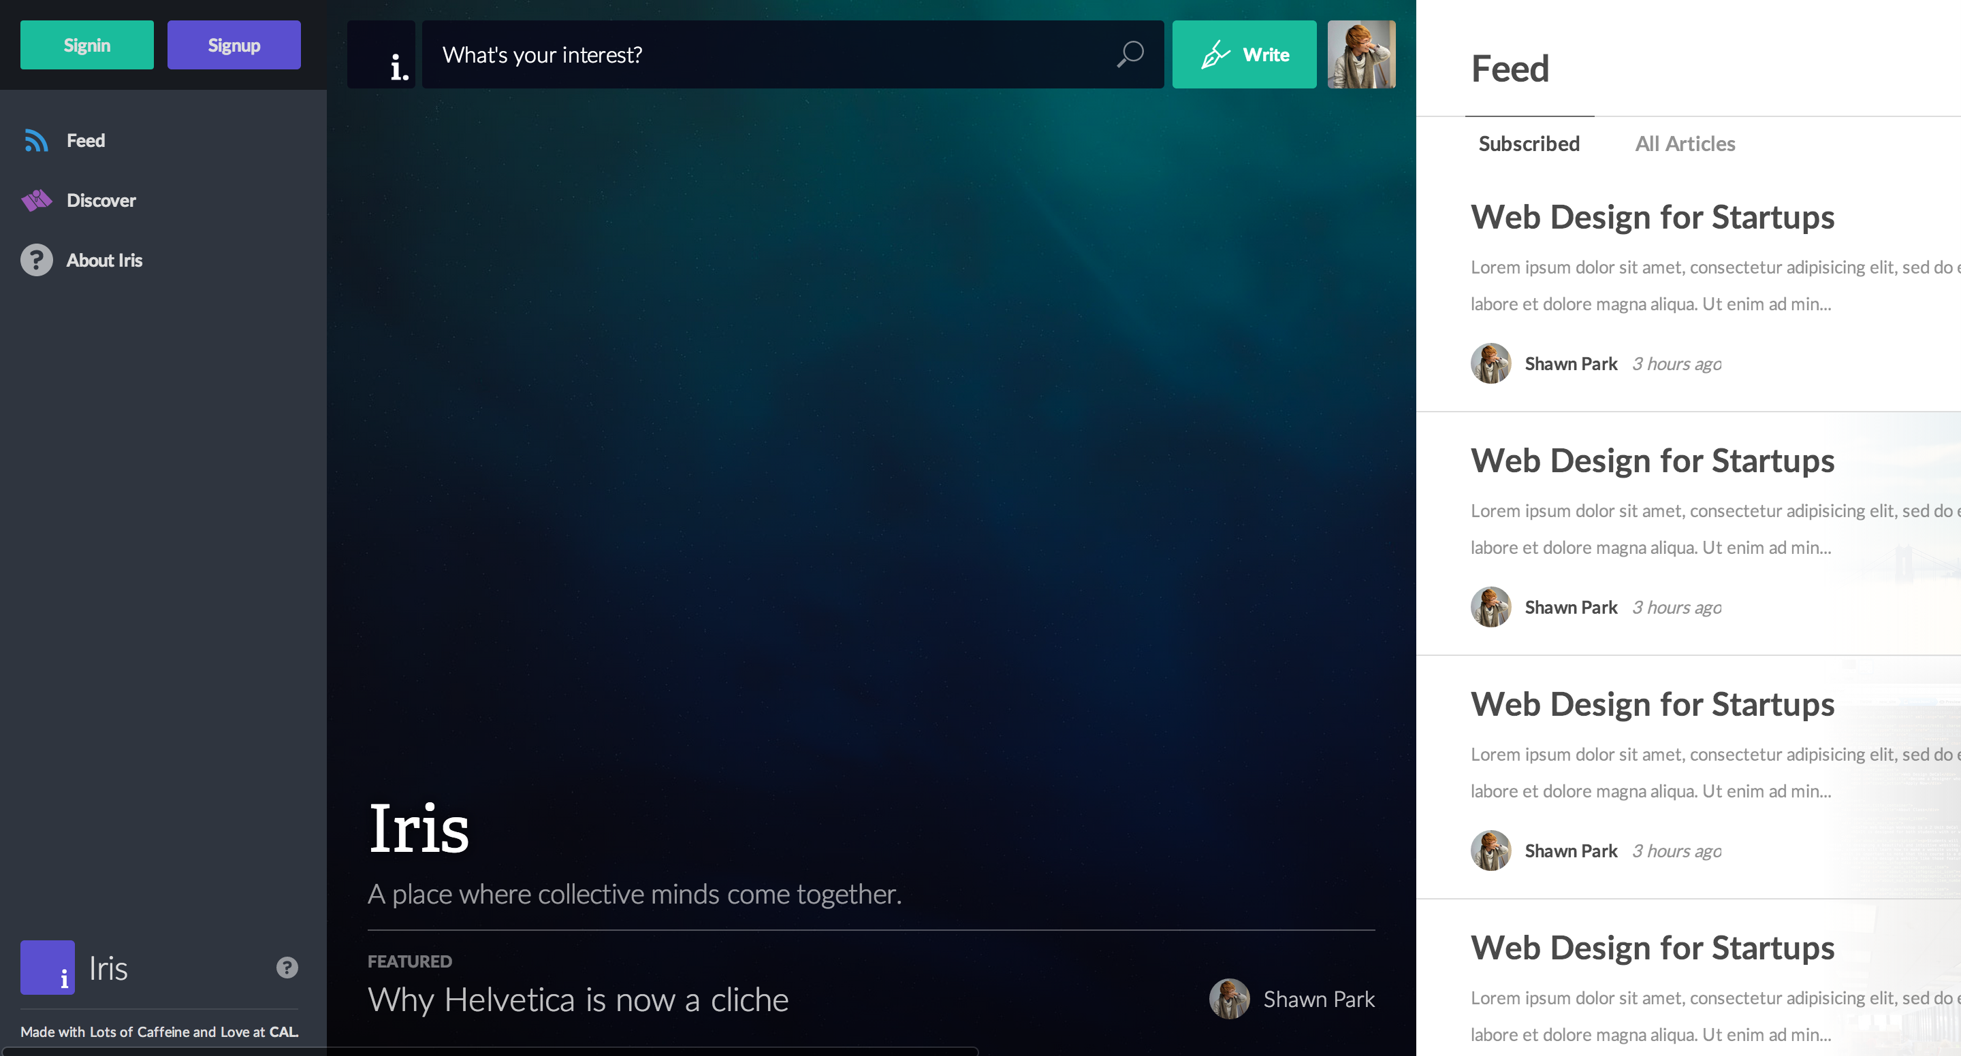
Use of contrast on Iris

Slide 30

Neon colored icon on dark background

Slide 31

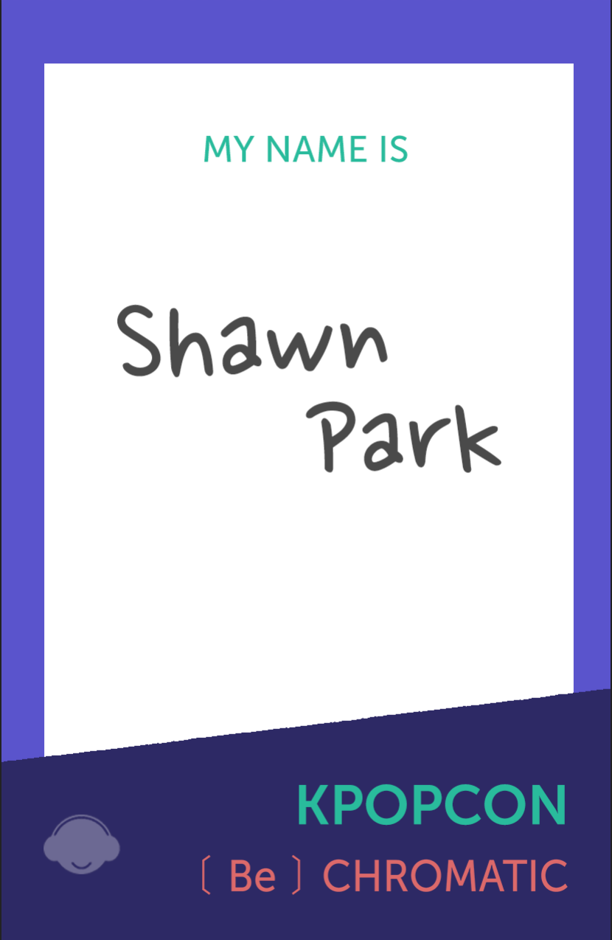
Effect of background color on contrast

Slide 32
Transparency
Also called “alpha layer”
Use transparency to deemphasize certain elements
Use solid color for main content and semi-transparent color for subcontent
Ex: rgba(0, 0, 0, 0.5) => 50% opacity black
Manipulate the last value from 0 ~ 1
Can also set transparency via opacity CSS attribute
Notes:
DEMO

Slide 33
Where do I find good color?
Other great websites
Go to web inspector and check what they use – take a sample and try to find a variation from that color
Photographs
Find a great color from your everyday life, take a photo, and use Photoshop or related software to extract color

Slide 34

You take a photograph…

Slide 35
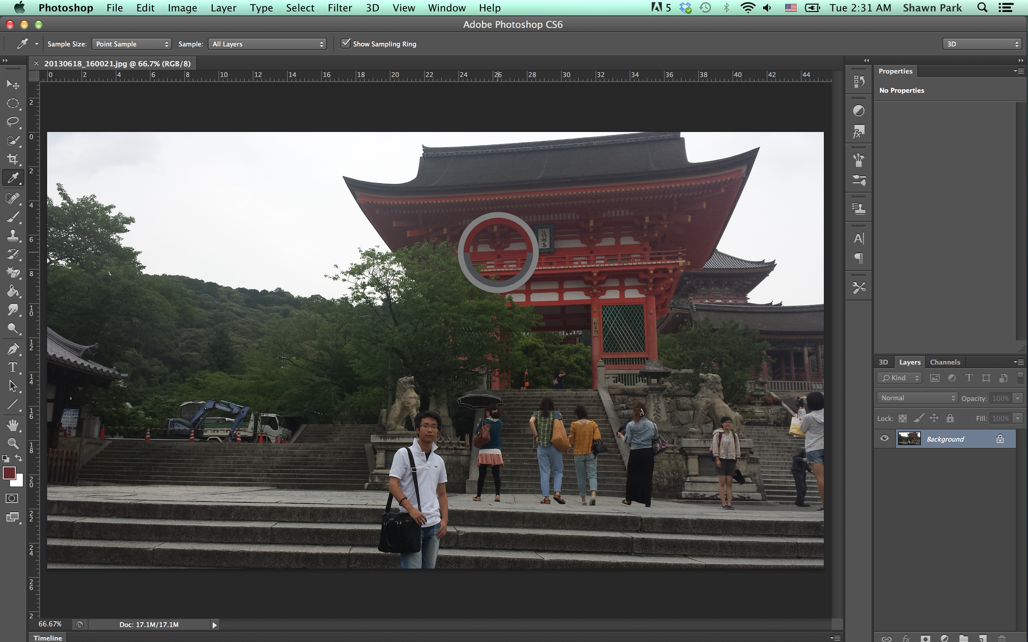
Extract the Color
Notes:
DEMO

Slide 36
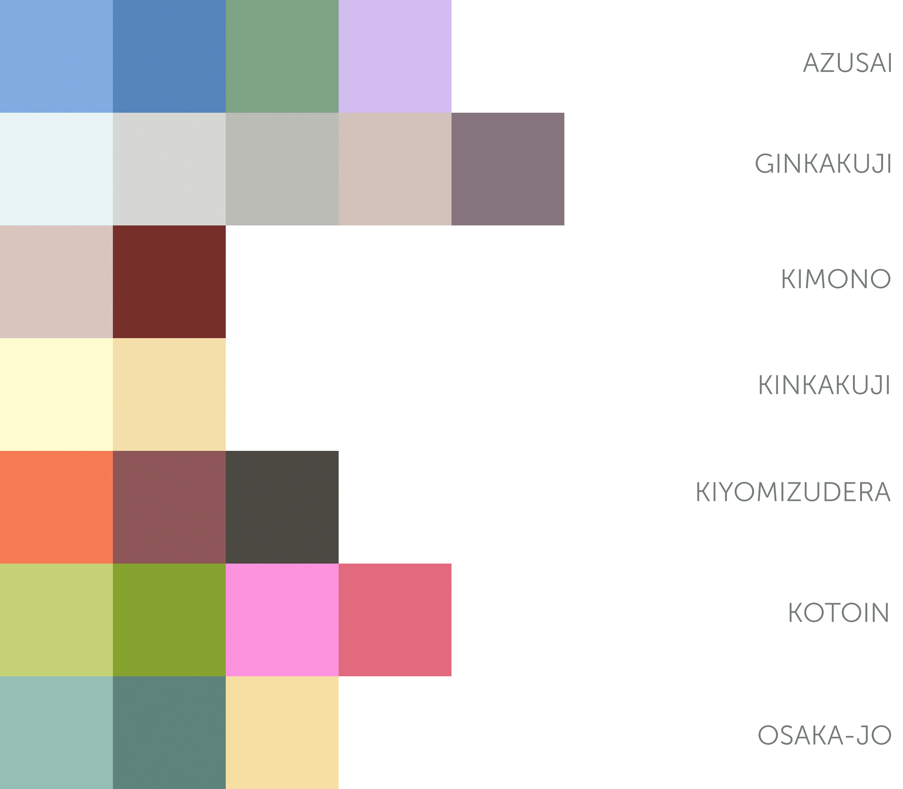
Organize them to create your color scheme!

Slide 37
Branding
A lot of companies create “Brand Guidelines” for their projects
A set of documents that set out how the design elements for a brand should be used.
Main goal is to provide consistency across their applications.
Includes:
Typeface
Color scheme
Spacing
Style / Tone

Slide 38

Google Visual Assets Guidelines

Slide 39
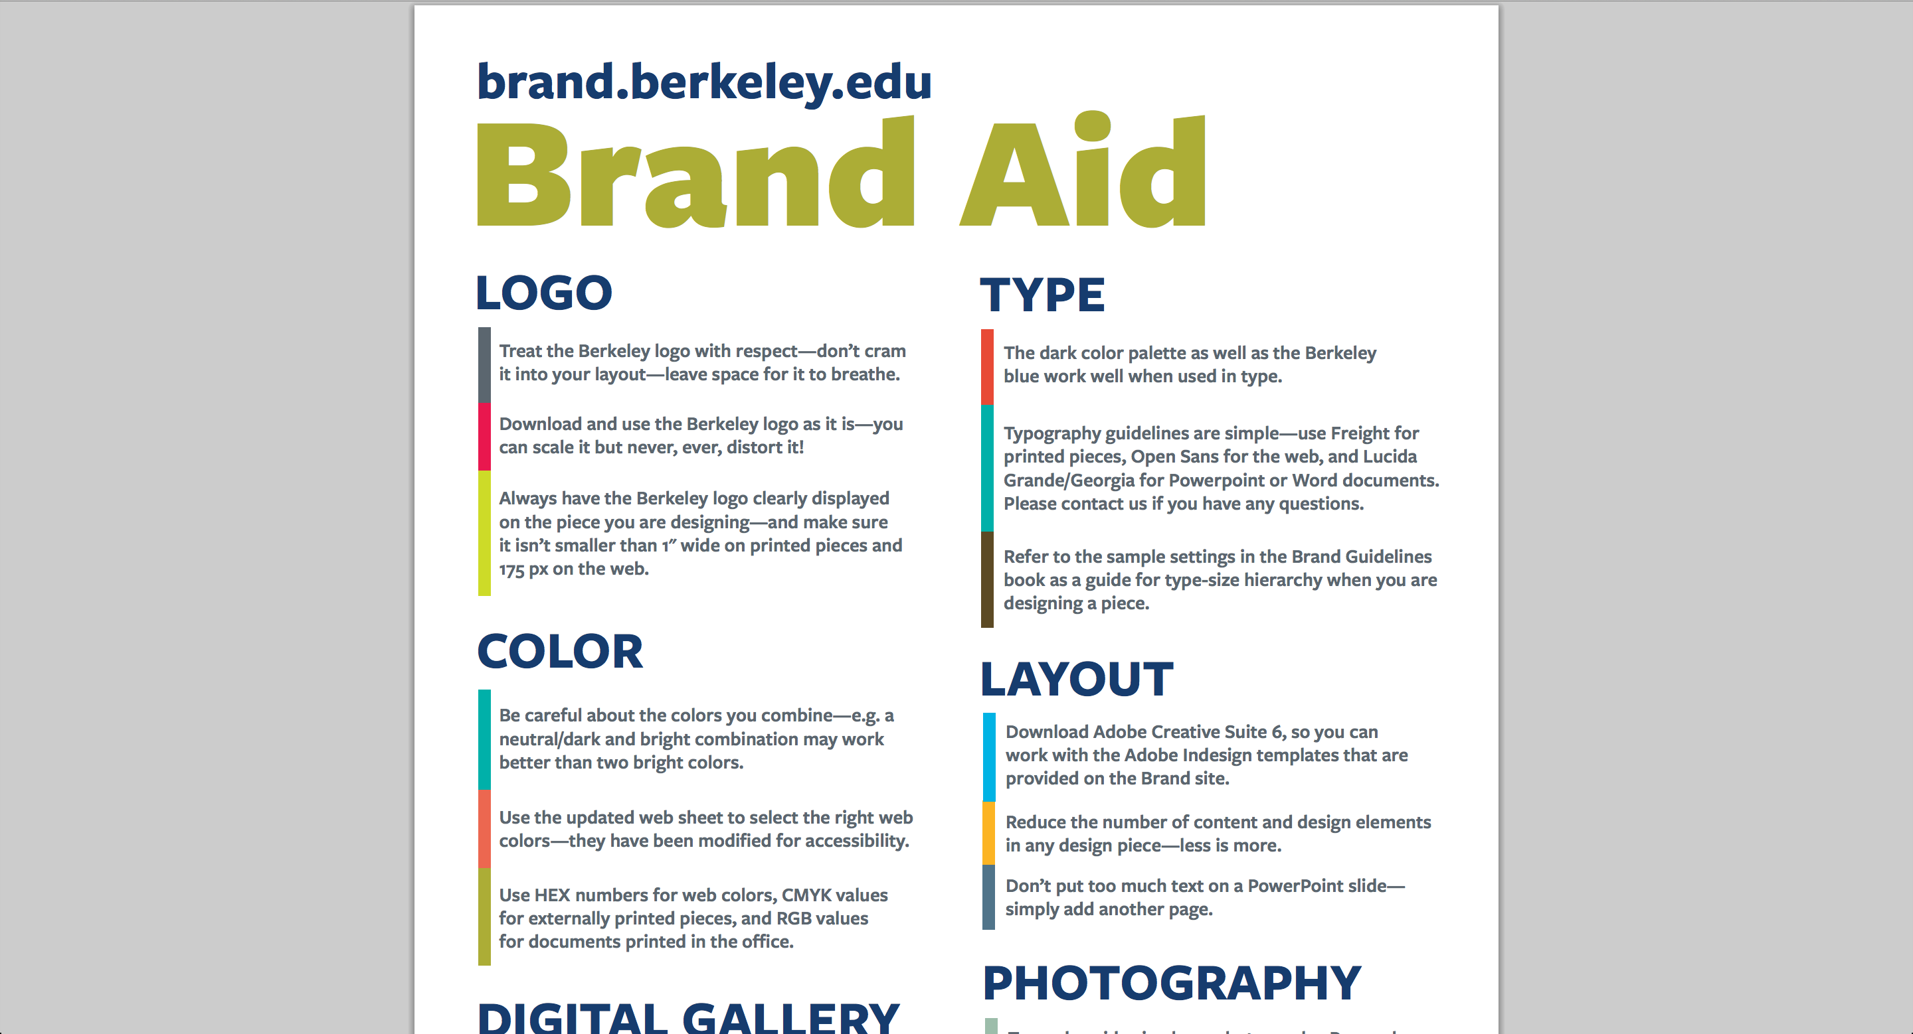
UC Berkeley Branding Guidelines

Slide 40
Brand Overview
What kind of emotion does your brand want to convey?
This is the vision for your brand and you should refer back to the brand overview for guidance as you design
Company cannot exist without vision
Design cannot exist without a general branding guideline

Slide 41
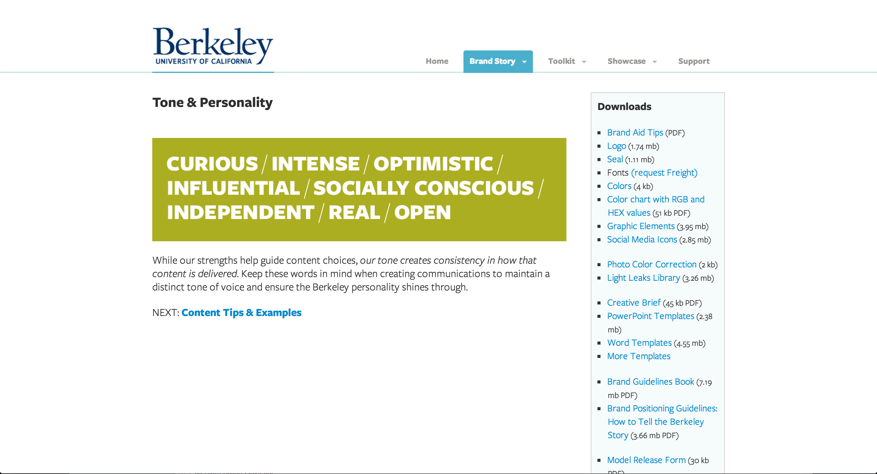
UC Berkeley Brand: Tone & Personality

Slide 42
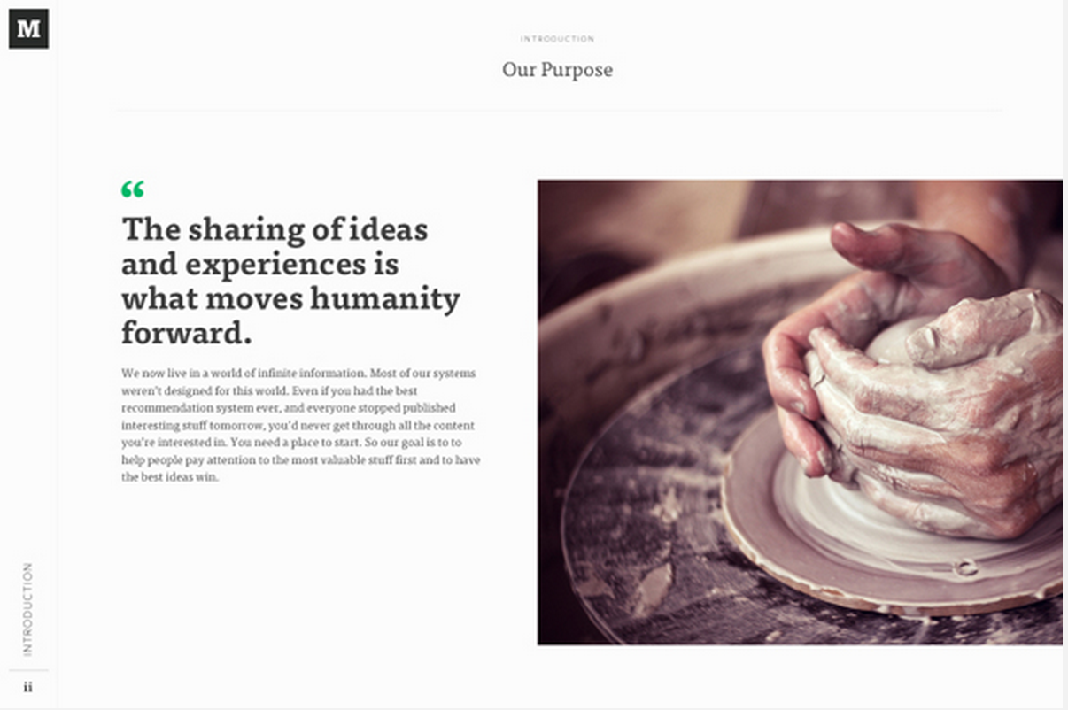
Medium Branding: Brand Overview

Slide 43
Logo
Think about brand recognition
Alphabet logos have very high brand recognition
Ex.: Facebook, McDonald’s, Tumblr
Think about brand identity
Your logo should relate to the name and vision of your client
Ex.: Apple, Microsoft, Dropbox
Stay away from ambiguous & cliché logos (Svbtle, Coin, Target)
Provide many different variations of logo

Slide 44

Microsoft’s New Logo

Slide 45
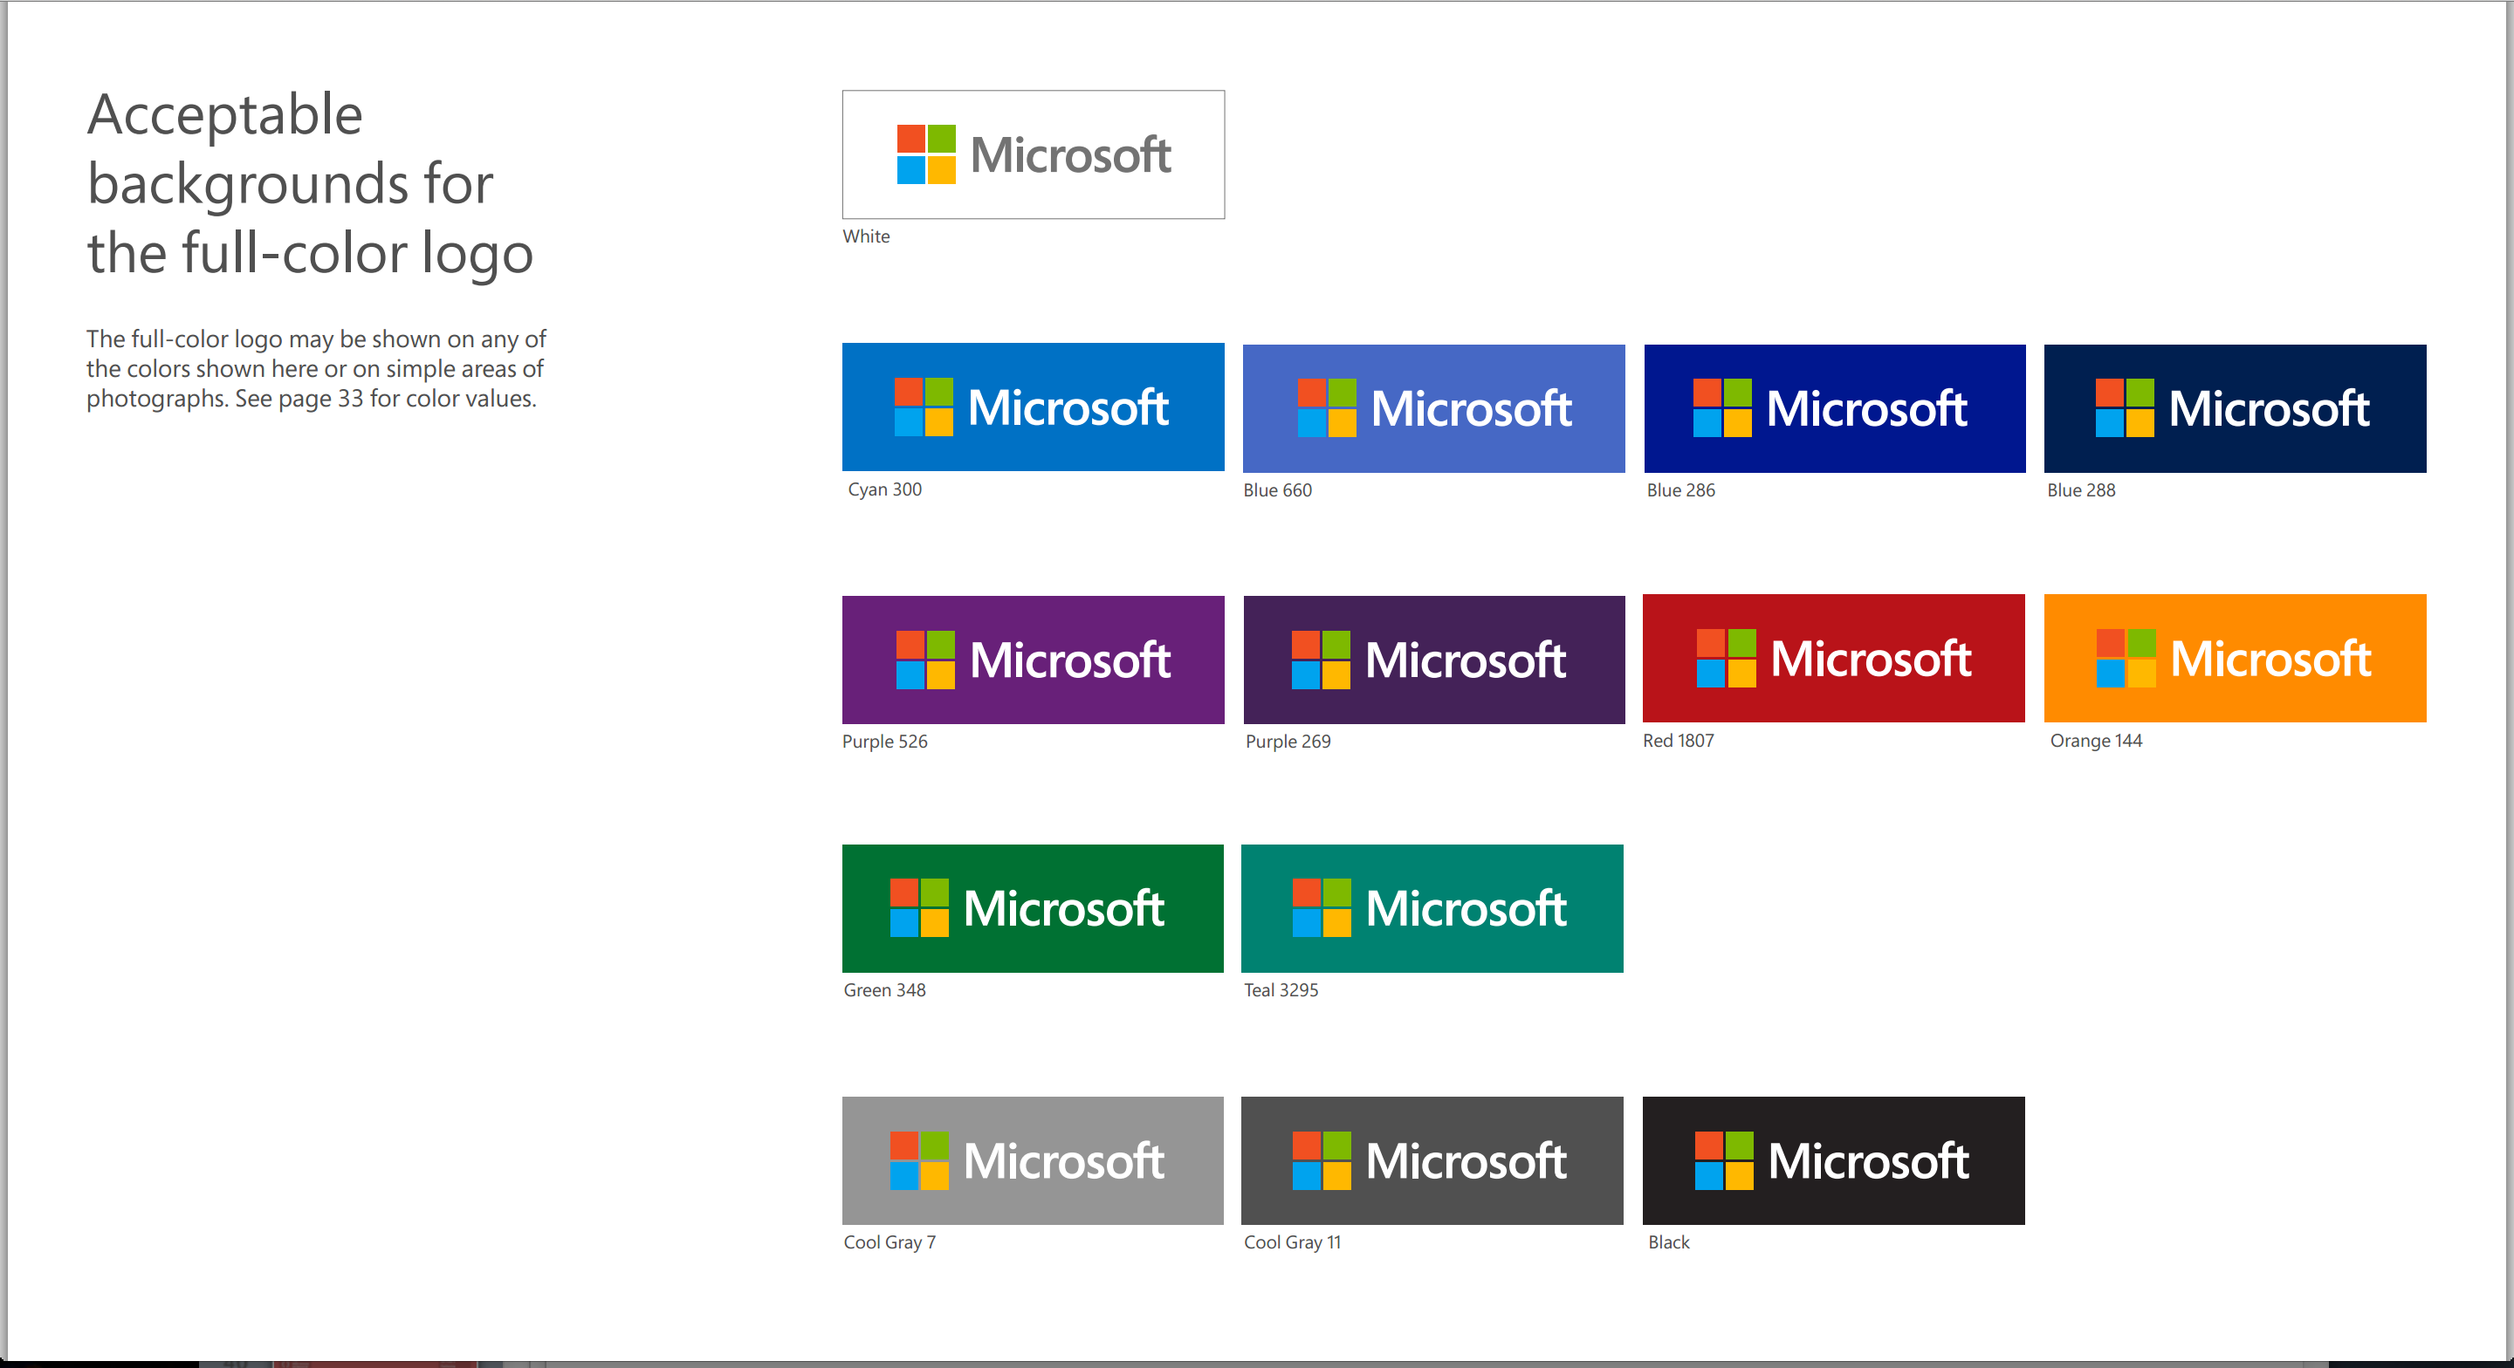
Microsoft’s New Logo

Slide 46
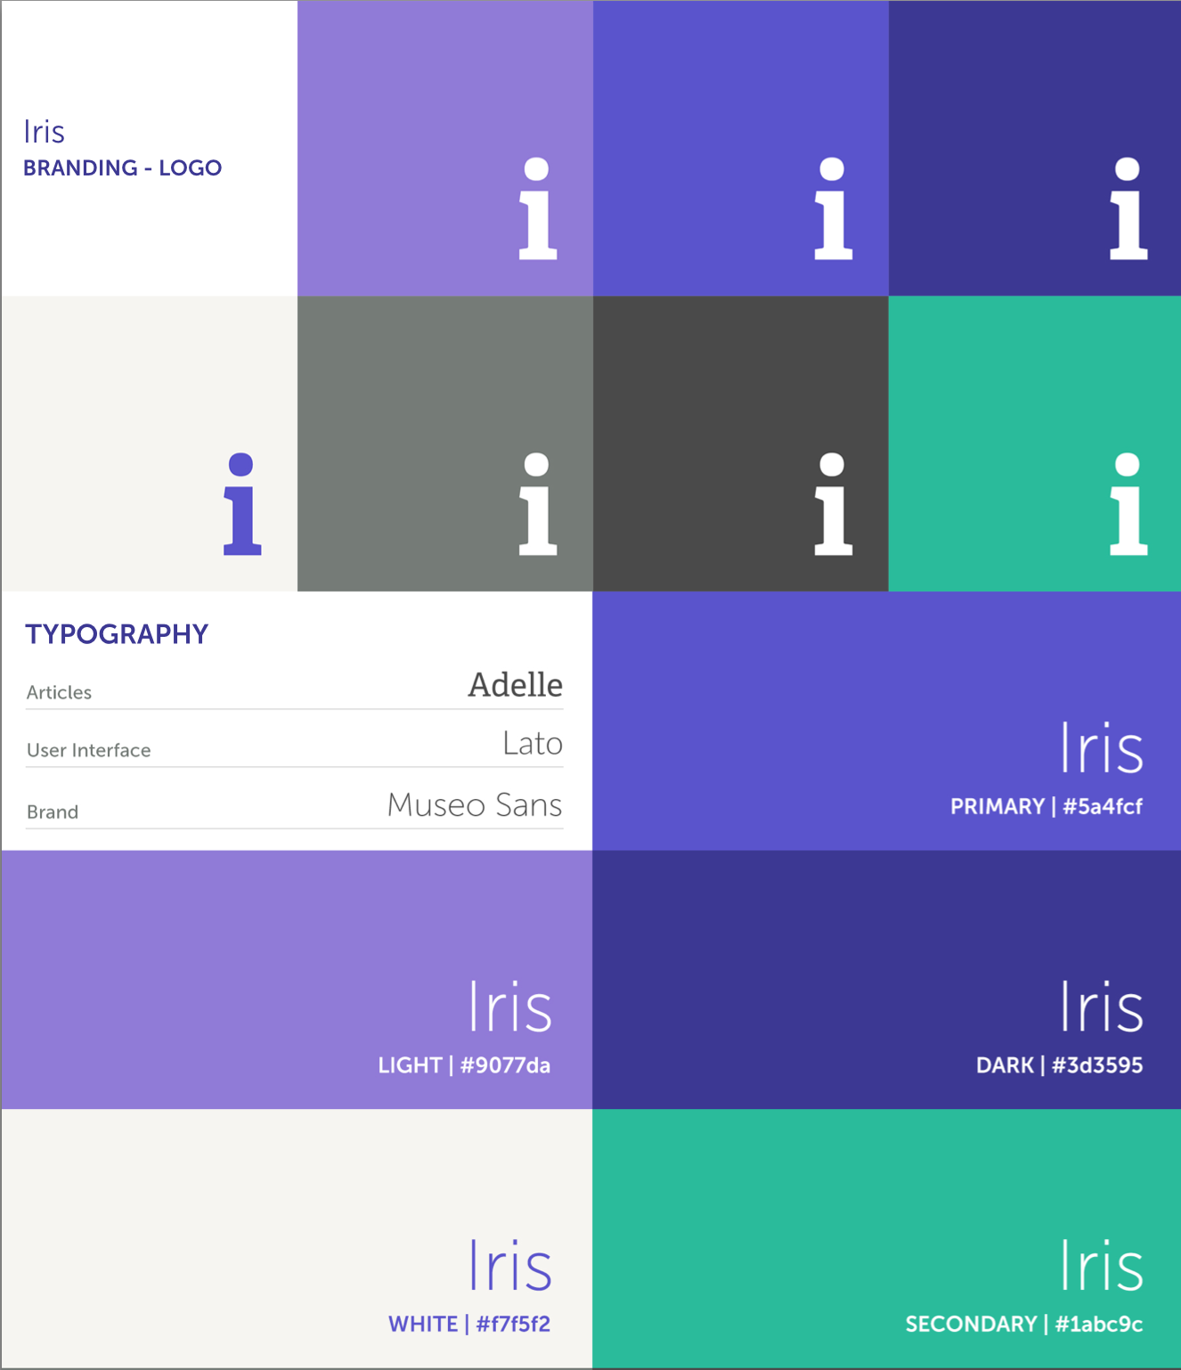
Iris Branding – Logo & Typography

Slide 47
Target Audience
Select your typography based on your target audience
Sans-serif: Young & Modern
Serif: Older & Classy & Text-heavy
Select your color scheme based on your target audience
Red: Relationship & Food
Yellow: Shopping
Blue: Business

Slide 48
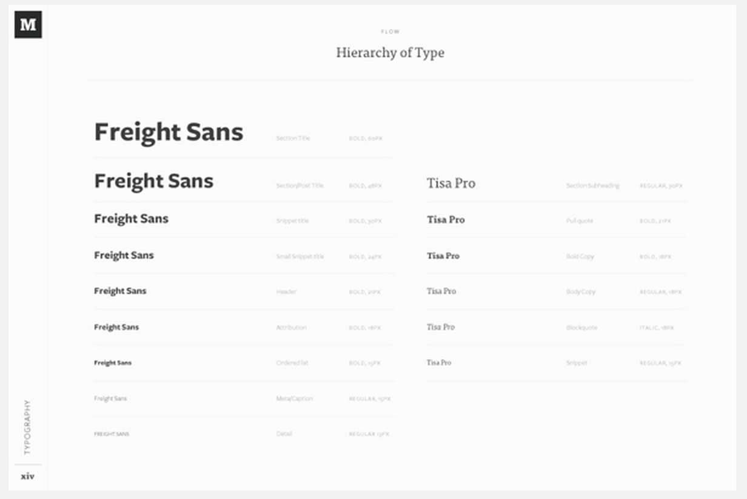
Medium Branding - Typography

Slide 49
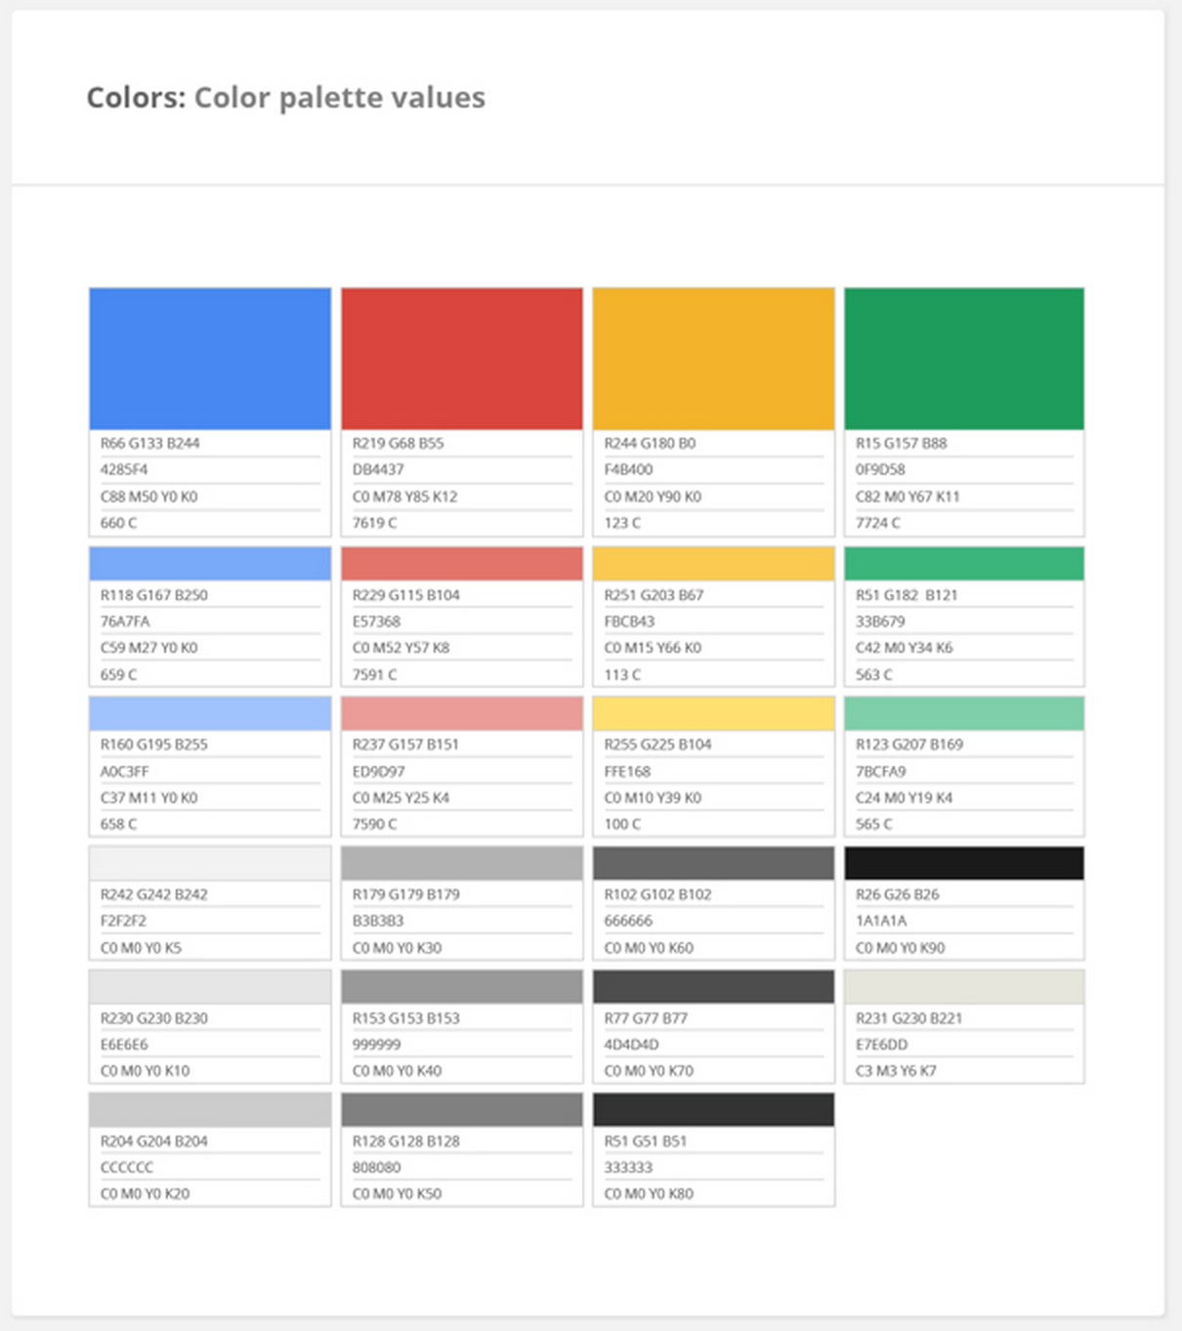
Google Branding – Color Pallette

Slide 50
Other Elements
Copy-writing
Tone of your writing style matters
Ex.: Apple
User Interface Elements
Provide different states of buttons used throughout the site
Provide a clear theme for your site

Slide 51
Consistency!
Notes:
Google Brand Guideline
Medium Brand Guideline

Slide 52
In-class Assignment: Branding

Slide 53
Today
Color Wheel
Primary Color – Red, Blue, Yellow
Secondary Color – Combination of Primary Colors
Tertiary Color – Combination of Primary Colors and Secondary Colors
Colors convey emotions – use them when building your color scheme
Limit your color scheme to 2-3 main theme colors and 1 light & 1 dark neutral color
Contrast & Consistency

